Slide 1

Romanian Green Certificates Market
in the new legislative context

Slide 2
Support System for E-RES
Established by Law
Fixed Quantities – mandatory quotas
Variable price – determined by market mechanisms
Minimum and maximum values established by Law
(27 €/certificate – 55 €/certificate )
For producers protection
For consumers protection
Instruments for promotion of electricity produced from renewable energy sources
- Green Certificates tradable on the Green Certificates Market -
opcom © All rights reserved 2

Slide 3
Support system for E-RES
Electricity Market
Offer
Green Certificates Market
Demand
Issuing GC
GC Register
“Consuming” GC
Registering GC
opcom © All rights reserved 3

Slide 4
Support system for E-RES
Romanian Energy Regulatory Authority
ANRE
Accredits Producers of E-SRE
Controls quota fulfilment
Applies penalties for non-compliance
Establishes the yearly mandatory quota of GC
Command and control at central level
Producers of E-RES
Transport and System Operator
TRANSELECTRICA
Issues GC
Green Certificates
Market
Economic Operators
With obligation to buy
GC
Network Operators
Romanian Power Market Operator
OPCOM
Assures the framework for GC trading
Administrates the Green Certificates Market
Administrates the Register for Green Certificates
Administrates the Register of GCM Participants
Competitive Market Mechanisms
opcom © All rights reserved 4

Slide 5
Primary Legislation
Law 134/18.07.2012 for the approval of the OUG 88/12.10.2011 regarding the amending and
completing the Law 220/2008 on establishing the promotion system of electricity production from RES
OUG 88/12.10.2011 on amending and completing the Law 220/2008 for establishing the support
system of the production of the E-RES, published in OJ MO 736/19.10.2011
Undertakes the amendments of EC to the Law 220/2008
GO 29/2010 on amending and completing the Law 220/2008 for establishing the support
system of the production of the E-RES
Systems for certification of the installers and information campaigns
Law 220/2008 for establishing the support system of the production of the E-RES, republished in
OJ 577/13.08.2010, Part I
opcom © All rights reserved 5

Slide 6
Secondary legislation
Ord. ANRE 42/20.10.2011 – Regulation for accreditation of the producers of E-RES for participation in
the support system by tradable green certificates
Ord. ANRE 43/20.10.2011 – Regulation for GC issuing
Ord. ANRE 44/20.10.2011 – Regulation for organization and functioning of the green certificates market
Ord. ANRE 45/20.10.2011 – Mehodology for setting of the annual quota of GC acquisition
Ord. ANRE 6/2012 – Methodology for monitoring the promotion system of E-RES by means of GC
opcom © All rights reserved 6

Slide 7
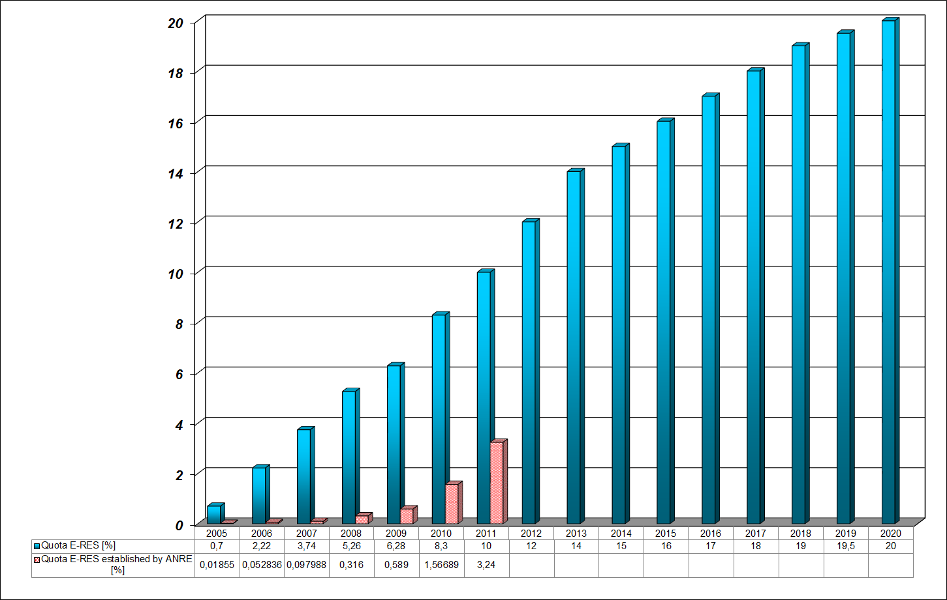
GCM – current state
E-RES Quotas: provided in the Law and realized
GC Quota established for 2011 by ANRE : 0,03746 GC/MWh
GC Quota estimated for 2012 by ANRE : 0,126 GC/MWh
opcom © All rights reserved 7

Slide 8
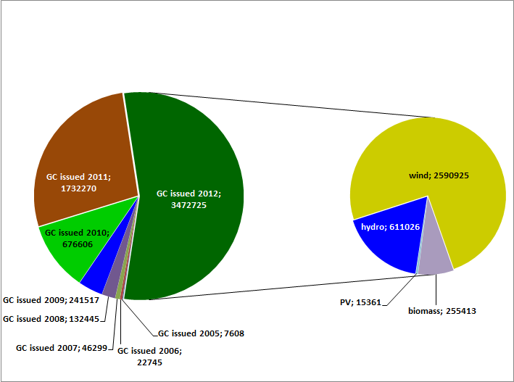
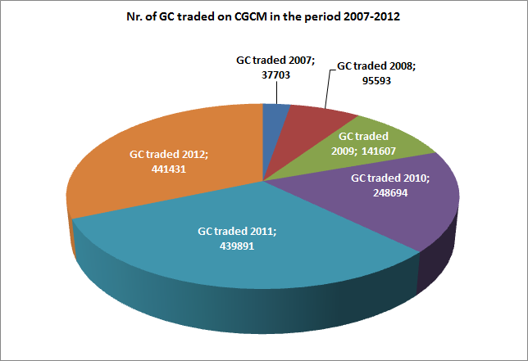

GCM – current state
Share of each type of RES in the total number of GC issued for E-RES produced in 2012
opcom © All rights reserved 8

Slide 9
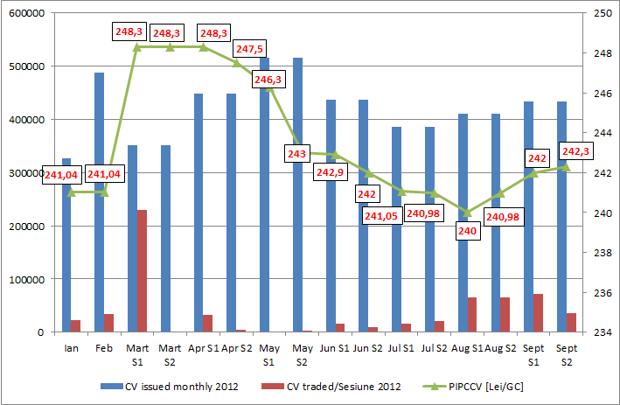
GCM – current state
opcom © All rights reserved 9

Slide 10
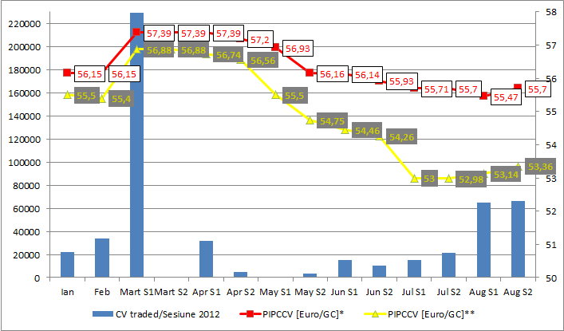

GCM – current state
opcom © All rights reserved 10

Slide 11
PCV – current state
Data from TRANSELECTRICA website
opcom © All rights reserved 11

Slide 12
Law 134/2012 for the approval of the OUG 88/12.10.2011 regarding the amending and completing the Law 220/2008 on establishing the promotion system of electricity production from RES, republished, with subsequent amendments
Are defined :
  Power plant multifuel
  Overcompensation
  Cost-benefit analysis
  Internal rate of return
  Energetic crops
  Priority acces to the network for E-RES
  Guaranteed acces to the network for E-RES
Additional provisions to the 220/2008 republished:
   For E-RES producers that received GC before applying the system provided in this Act, the duration of applying
  the system will be diminished according to the period for which they already received GC.
   Producers of electricity from : biomass, bioliquids, biogas, can benefit from the promotion system established
  by the Law only if they own certificates attesting the origin of those energy sources, issued by accredited institutions.
opcom © All rights reserved 12

Slide 13
Law 134/2012 for the approval of the OUG 88/12.10.2011 regarding the amending and completing the Law 220/2008 on establishing the promotion system of electricity production from RES, republished, with subsequent amendments
Number of GC issued for 1 MWh E-RES:
  for electricity produced in hydropower plants with capacity up to 10 MW:
    3 GC/1 MWh if the plants are new
    2 GC/1 MWh if the power plants are refurbished
    1 GC/2 MWh if the power plants are old and are not refurbished
  for electricity produced in wind power plants:
    2 GC/1 MWh, until 2017
    1 GC/1 MWh starting with 2018
  for electricity produced in power plants wich use: geothermal energy, biomass, bioliquids, biogas:
    2 GC/1 MWh
  for electricity produced in power plants wich use gas from wastes processing, gas from the process of
  fermentation of sludge from wastewater treatment plants:
    1 GC/1 MWh
  for electricity produced in power plants wich use solar energy:
    6 GC/1 MWh
  for electricity produced in high efficiency cogeneration in power plants which use biomass :
    1 GC/1 MWh additional
  for electricity produced in power plants which use biomass from energetic crops or forestry wastes:
    1 GC/1 MWh additional
  for testing period, whatever the type of the renewable energy source :
    1 GC/1 MWh
  for power plants which benefit from Investment Aid :
    the number of GC/MWh is reduced according to the reduction of the reference value of the investition per MWh
    with the value of the Investment Aid received (for example 1,12 GC/MWh instead of 2 GC/MWh))
opcom © All rights reserved 13

Slide 14
GCM – current state
Price limits applied:  27 ÷ 55 euro
 exchange rate used: average of the december of the previous year
established by National Romanian Bank  indexed with the average inflation index of Euro registered in the
previous year for euro zone, communicated officialy by EUROSTAT
Penalties for non-compliance:  110 euro
 exchange rate used : average of the december of the previous year
established by National Romanian Bank
 indexed with the average inflation index of Euro registered in the
previous year for euro zone, communicated officialy by EUROSTAT
 55 euro for noncompliance with the yearly quota quarterly
Collection of penalties:  Administration of Environment Fund (yearly)
 Guarantee Fund for functioning of GCM (quarterly)
Use of penalties:  Financing the investments in E-RES production by persons wich
realize installations with capacity up to 100 kW (Administration of
Environment Fund)
 Buying the GC unsold becose of quota nonfulfilment quarterly, at
the request od the producers (Guarantee Fund)
Duration of support scheme application:  15 years for new installations
 10 years for hydro power plants with installed capacity up to 10 MW, refurbished  7 years for power plants used before in other states
 commissining/refurbisment until the end of 2016
opcom © All rights reserved 14

Slide 15
Law 134/2012 for the approval of the OUG 88/12.10.2011 regarding the amending and completing the Law 220/2008 on establishing the promotion system of electricity production from RES, republished, with subsequent amendments
Changes :
Period of valability of GC: 16 months from the issuing date
The quantity of electricity for which is established the obligation of GC acquisition includes:
  electricity bought by suppliers of electricity, for their final consumption as well as for selling it to final
  consumers
  electricity used for own final consumption, other than own technological consumption, by a producer of electricity
  electricity used by a producer for supplying with electricity the consumers connected by direct lines to the
  power plant
Price limits and value of penalty :
  are indexed yearly by ANRE with the average inflation index of euro, for the previous year, calculated for euro zone,
  communicated officialy by EUROSTAT
  The calculation of fulfilled quotas for the economical agents with obligation, will be quaterly
Penalties collection: Administration of the Fund for Environment
Producers that own power plants with installed capacity up to 1 MW/plant or 2 MW/plant for high efficiency biomass cogeneration can sell the electricity with regulated prices, unique for each type of technology and not receive GC.
The Guarantee Fund-administrated by OPCOM
opcom © All rights reserved 15

Slide 16
Law 134/2012 for the approval of the OUG 88/12.10.2011 regarding the amending and completing the Law 220/2008 on establishing the promotion system of electricity production from RES, republished, with subsequent amendments
Other provisions:
Priority dispatching for E-RES so that the effective production is as close to the availability of these resources
Limiting or stopping the production of E-RES will be made only upon the technical and commercial regulations approved by ANRE or in exceptional cases , where such action is absolutely necessary to maintain stability and meet safety of national system of electricity.
Guaranteed acces to the network: E-RES that benefits of support system by tradable GC, contracted and sold on the electricity market
Priority acces to the network: E-RES contracted and sold with regulated price
Network connection is made to the extent that the safty of the national electricity system is not affected
Producers which develop projects for E-RES production in power plants with installed capacity grater than 125 MW:
    are obliged to notify them separately to EC.
    receive GC only after they receive authorization from EC
opcom © All rights reserved 16

Slide 17
Secondary legislation – Role of OPCOM
Regulation for organizing and functioning of green certificates market
Administrator of the green certificates market: green certificates market consists of centralized green certificates market and bilateral contracts for green certificates
Operator of the centralized green certificates market
Administrator of the Register of the green certificates market participants
Administrator of the Register of green certificates: Each participant on GCM has an account of GC in the register of GC, in which are registered the codes of identification of GC that the participant own and their state – valid, cancelled, transferred or consumed
OPCOM transfers GC from the seller account to the buyer account after receiving the confirmation of payment of financial obligation, both for transactions on centralized market and on bilateral contracts.
opcom © All rights reserved 17

Slide 18
Secondary legislation – Role of OPCOM
According to the provisions of the Law 134/2012, Opcom has the obligation to constitute the Guarantee Fund for the functioning of GCM
  The Fund consists of the money paid by the suppliers which didn’t fulfilled their quota each quarter; for each GC missing from the quota will be paid the maximum price of GC calculated by ANRE for the respective year
  The money of the Guarantee Fund will be used by OPCOM to buy GC unsold in the respective quarter because of quota nonfulfillment, at the producers request
Opcom elaborates the Regulation for the establishing and use of the Guarantee Fund for the functioning of GCM
Opcom calculates and publishes quarterly, the weighted average price on the CGCM
Opcom proposed the amendments of the Regulation for organizing and functioning of CGM; the Draft of this document is published on Opcom’s website for comments
opcom © All rights reserved 18

Slide 19
Thank you for your attention !
www.opcom.ro

